Slide 1
Welcome to the Press Conference EIB Supports Croatia’s Competitiveness
Dario Scannapieco EIB Vice-President
Zagreb
30 March 2015

Slide 2
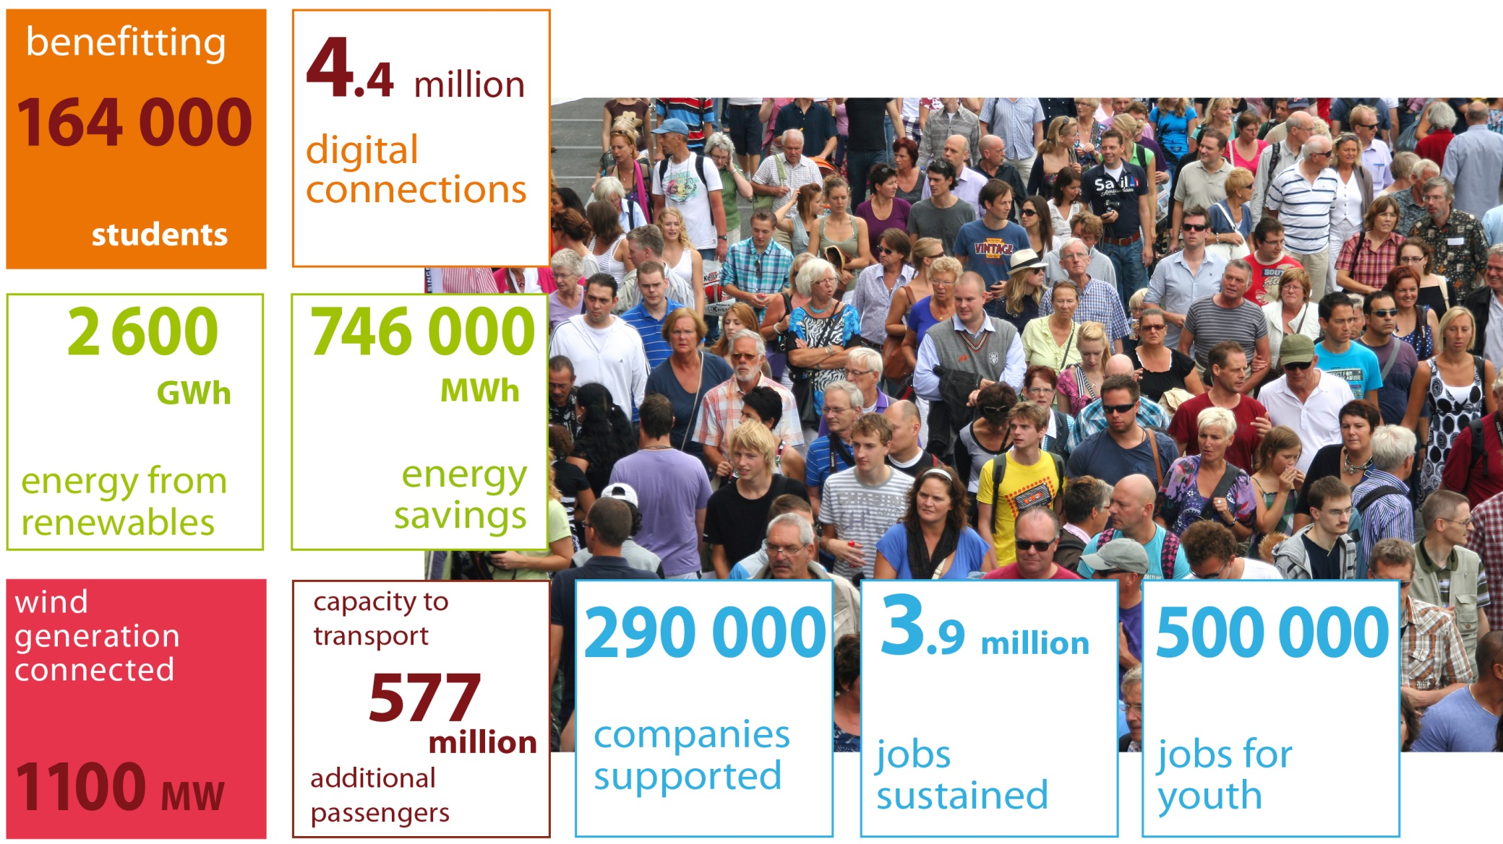
EIB Group activities make a difference

Slide 3
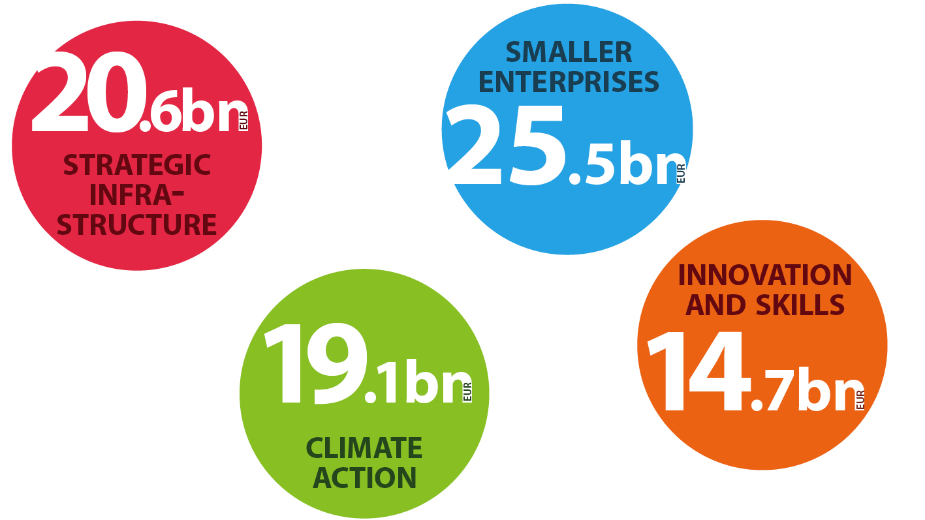
EIB Lending under key priorities in 2014
YOUTH
13.0bn

Slide 4
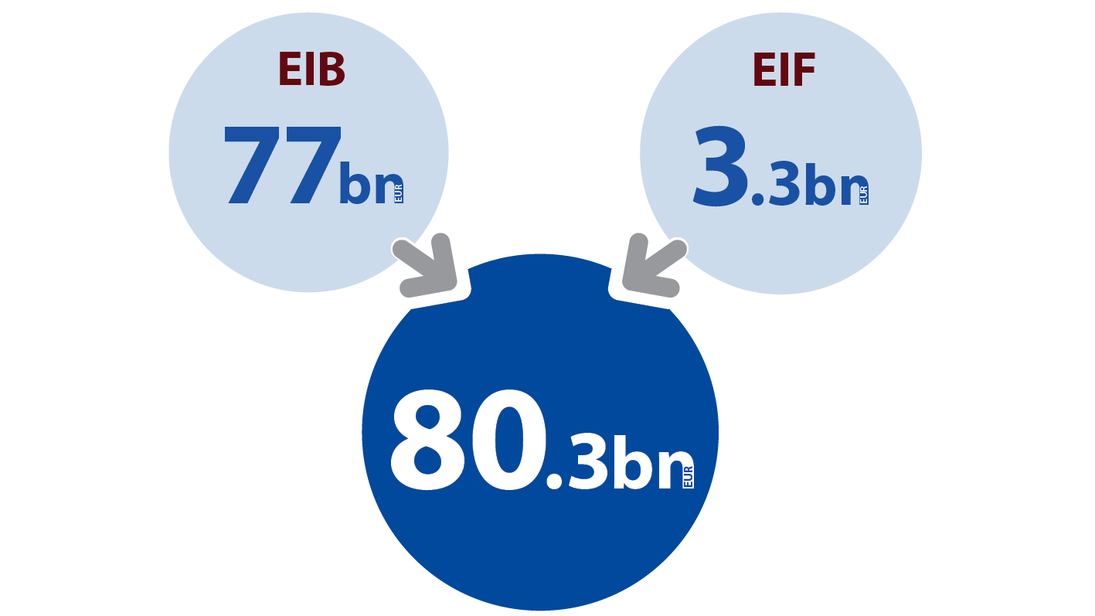
EIB Group lending in 2014

Slide 5
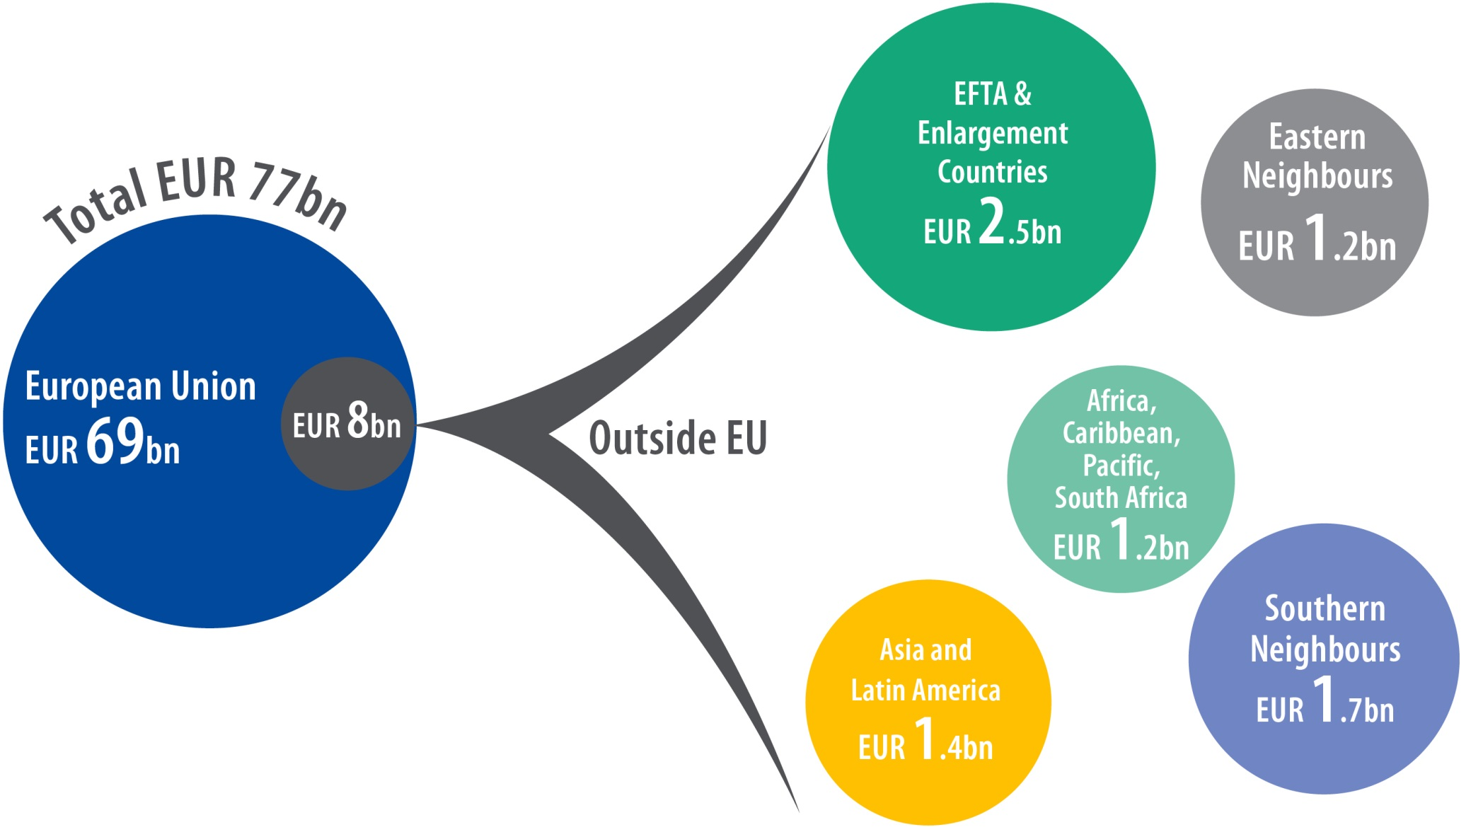
Lending outside EU in 2014: EUR 8bn (EIB signatures)
.
European Investment Bank Group
5
Notes:
5

Slide 6
EIB lending in Croatia in 2010 - 2014
In 2014 the disbursement of EIB loans reached with EUR 445m the second ever highest level, representing a 32% increase compared to 2013 disbursement of EUR 338m

Slide 7
EIB lending in Croatia in 2000-2014 per sectors (EUR 4.6bn)

Slide 8
EIB project financing in Croatia in 2014
Loans for SMEs and midcaps
EUR 535m to finance projects promoted by small and medium-sized enterprises and midcap companies in Croatia
EIB credit lines were provided to:
HBOR,
Erste & Steiermaerkische Bank d.d,
Privredna Banka Zagreb d.d.,
Raiffeisen Leasing d.d. and
Société Générale Splitska Banka d.d
Project example:
A EUR 65 200 loan via Privredna Banka
Zagreb to INSPECTO Ltd enabled
the company to purchase state-of-the-art
laboratory equipment to expand
its service offering with human health
as a top priority.

Slide 9
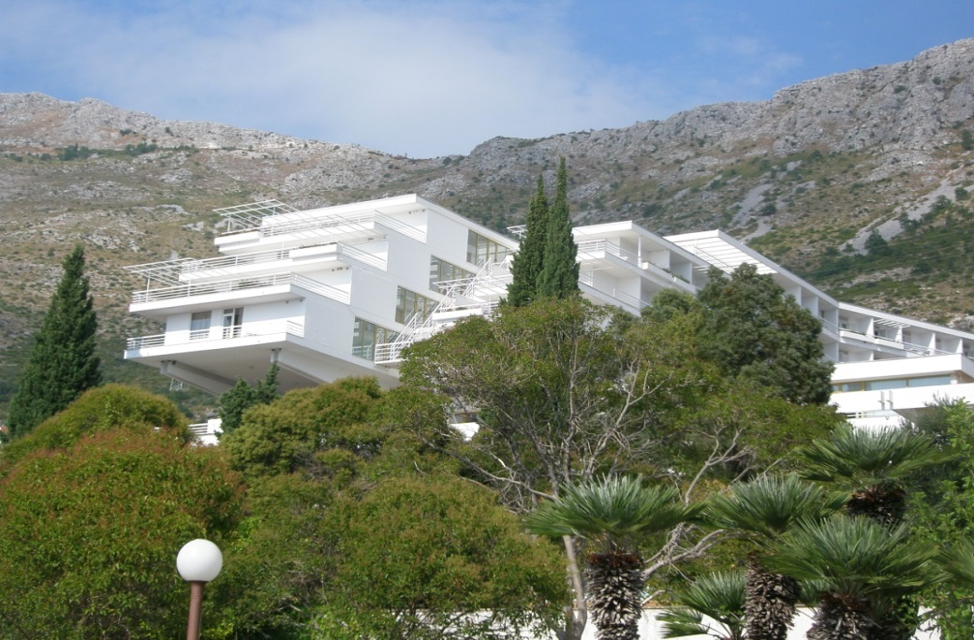
EIB project financing in Croatia in 2014
Support to the development of tourism infrastructure
EUR 25 m loan on lend through HBOR to Hoteli Dubrovacka Rivijera d.d.,
Objectives:
Modernisation and refurbishment of two existing hotels and the rebuilding of another hotel that suffered substantial war damage in the early 1990s.
upgrade hotel infrastructure - key factor for further development of tourism in Croatia
The project will either create or secure a total of some 400 full time jobs, including the indirect employment

Slide 10
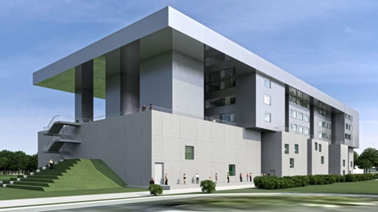
Continual support to Croatian public infrastructure
Existing credit lines for state and public institutions are being actively utilised generating additional EIB support to public sectors projects.
Project examples:
South-East European Centre for Entrepreneurial Learning
Rijeka University Campus
Various municipal water and wastewater treatment facilities promoted by Hrvatska Vode
Co-financing of the works for the rehabilitation of Zagreb Main Railway Station
Reconstruction of the Okucani-Novska Railway Line

Slide 11
JASPERS in 2014
Joint Assistance to Support Projects in European Regions
A Technical Support Facility, managed by the EIB, and co-sponsored by the Commission, EIB and EBRD helping to absorb EU Structural and Cohesion Funds to finance required investments in areas in need of regional development
Croatia is the first country that benefitted from JASPERS prior to joining the EU
Assistance provided free of charge by the Commission and the EIB
Up to the end of 2014 JASPERS completed 19 projects in Croatia with estimated total costs of some EUR 1.2 billion
Currently JASPERS deals with 96 active projects in Croatia with estimated total costs of some EUR 6.3 billion
Sectors concern notably water /waste, public transport, roads, knowledge economy, energy.

Slide 12
The EIF in 2014
EIF in Total
EUR 1.65bn for equity in 74 early and growth stage funds raising EUR 8.3bn.
On the guarantees side - EUR 1.6bn in 60 transactions attracting EUR 5.6bn of new loans for SMEs.
Support for micro-enterprises across the EU-28 totalled EUR 51m, generating a loan volume of EUR 133m. More than 175 000 SMEs were supported by the EIF in 2014.
EIF in Croatia
committed EUR 13.2m in 2 guarantee and 2 microfinance operations, which aim to raise EUR 36m.

Slide 13
Prospects for future EIB activities in Croatia
EIB Group will continue its counter-cyclical support for growth and jobs:
EIB Group focus in the near future:
EIB co-financing with EU Structural and Investment Funds 2014-2020 Actively implementing the project signed today with the Ministry of Regional Development and EU Funds and the Ministry of Finance. EIB could provide lending to fund the national contribution necessary to access the EU grant funding:
In sectors such as sustainable transport (roads, rail and municipal transport); water & environmental protection; rural development;
EFSI (Juncker Plan)
Identification and financing of projects to be supported under the European Fund for Strategic Investments
Health Sector:
Hospital in Pula
Access of SMEs and Mid-Cap companies to long term finance:
Continuation of supporting SMEs and MidCaps through HBOR
New credit lines with other intermediaries in Croatia are in the pipeline
Competitive Energy and Energy efficiency
Infrastructure and industry projects are being actively identified

Slide 14
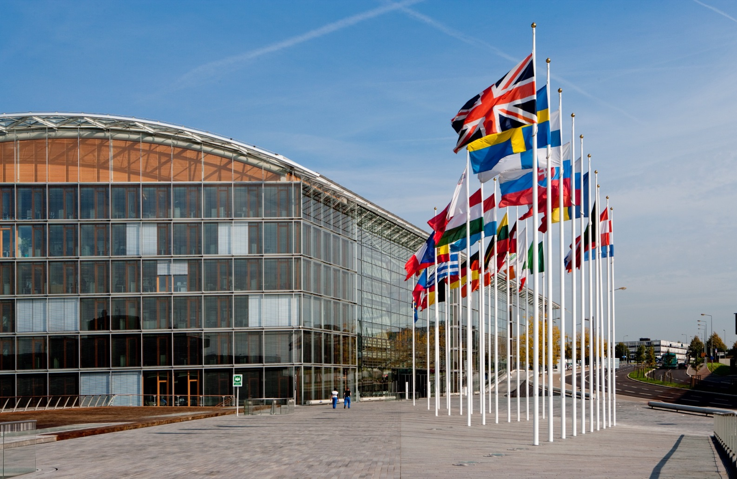
Thank you for your attention! Q&A Session

